Slide 1
Robots with four wheels
Drive forward or back wheels
Drive and turn both forward and back wheels

Slide 2
Sensors are an important part of a mobile robot

Slide 3
Four wheeled robots
Four standard wheels controlled in pairs in the skid steering system

Slide 5
More of the well-known Four Wheel Robots

Slide 6
Four wheels = Mecanum Wheels
Uranus CMU
Mister Jeeves PSU

Slide 7
Mecanum Wheel Control Variables

Slide 9
Omni-Directional Vehicles
Most vehicles are non-holonomic
this means they cannot drive in all directions
E.g. a differential-drive vehicle cannot drive in the direction of its wheel axis
Holonomic vehicles can drive in any possible direction

Slide 10
Design of holonomic vehicles

Slide 11
Examples of using four motors to control four mecanum wheels for a holonomic robot
Resultant force
Four motors, all forward here
Go holonomically left
Rotate rigth in place

Slide 12
Go forward

Slide 13
Go holonomically right

Slide 14
Turn right in place

Slide 15
Examples of motions

Slide 16
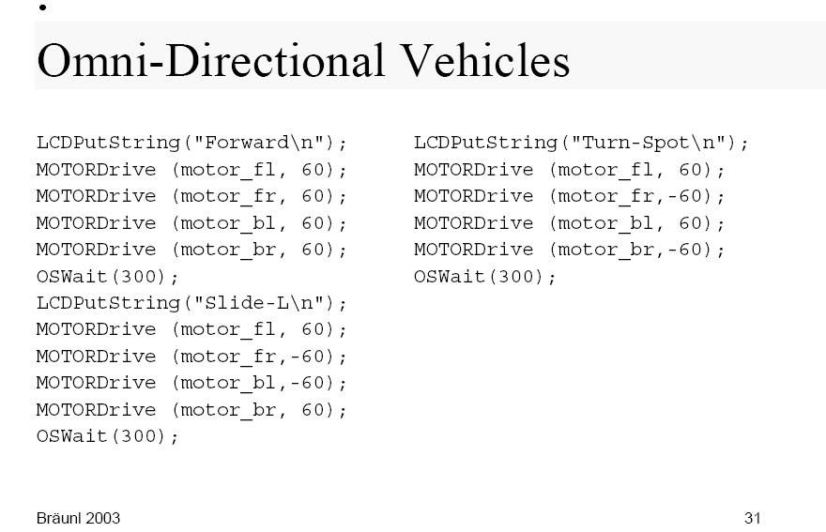
Software for Omni-Directional Vehicles

Slide 17
Matrix motion description for Mecanum Wheels
Rotation angles derivatives of wheels
Velocities and angle

Slide 18
Example of a robot with Omni Wheels: OMNI-1

Slide 19
Example of a robot with Omni Wheels: OMNI-2

Slide 20
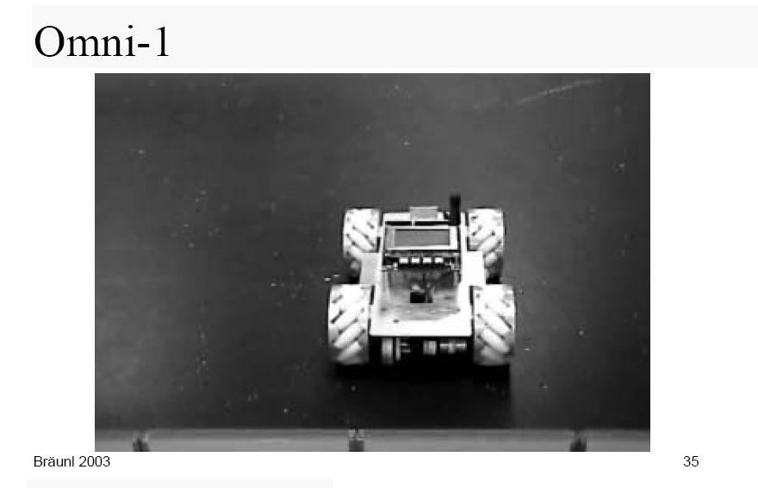

Slide 21
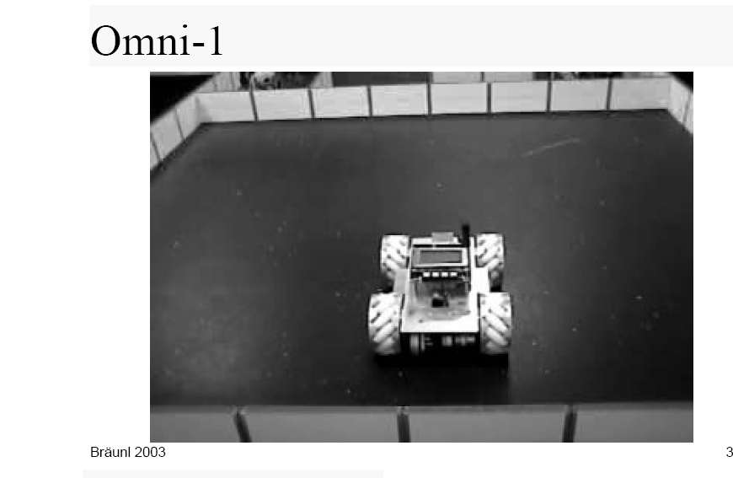

Slide 22
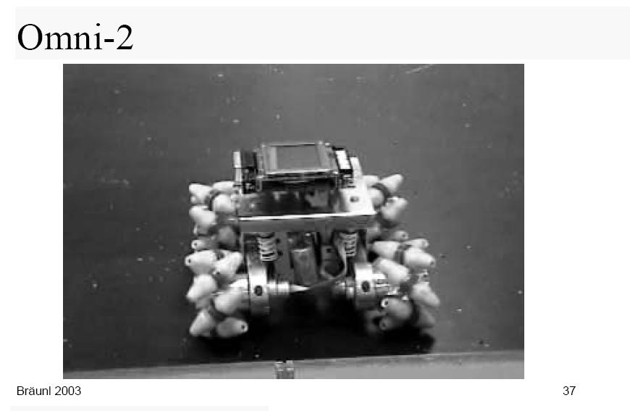

Slide 23
Design of new types of robots that combine mobile and walking

Slide 25
Real-World Applications need new types of robots

Slide 26
Role of sensors

Slide 28
Robots that walk, how?

